Slide 1
ESP-NOW Protocol
Tran Le Minh Quan
22CE.B022

Slide 2
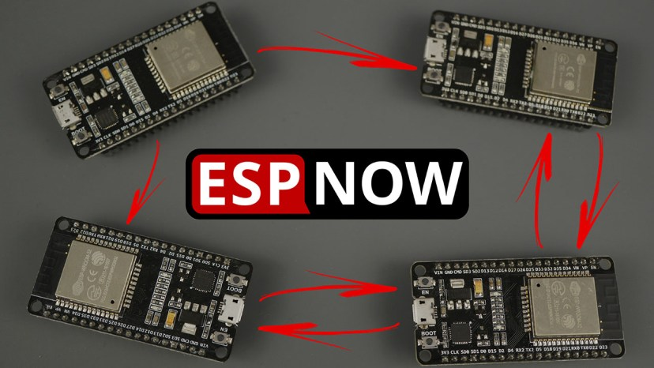
1. What is ESP-NOW:
- To put it simply, ESP-NOW is a proprietary wireless communication protocol of Espressif. It is designed to allow microcontrollers (like ESP32, ESP8266) to send data for each other.
- It just like a digital phone for ESP chip:
+ They talk directly to each other (device-to-device)
+ Don’t need intermediate equiment (like Router of Wi-Fi)
+ It is not Wi-Fi and it is not Bluetooth. It is a separate protocol that runs on the 2.4GHz band

Slide 3
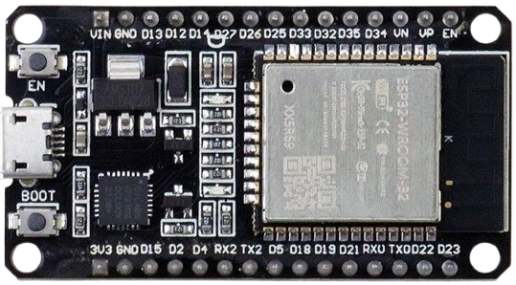
2. How it work “hidden” inside:
- Connectionless: This is the main point. ESP-NOW don’t need a “handshake” to set up and maintain connections. It just send data packets
- Identifies by MAC address: Instead of using IP addresses, it identifies sending and receiving devices by MAC addresses.
Send to 8D:49:59:63:FC:C4
Receive from CD:89:49:53:F8:C4
CD:89:49:53:F8:C4
8D:49:59:63:FC:C4
ESP-NOW

Slide 4
3. Set up send and receive device:
a. Send device:
- Step 1: Initialize Network and ESP-NOW
- Step 2: Add a peer device (the receiver). You need to know the receiver MAC address
- Step 3: Send a message to the peer device
- Step 4: Process the result
Send to 8D:49:59:63:FC:C4
CD:89:49:53:F8:C4

Slide 5
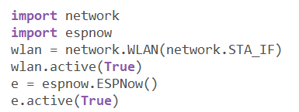
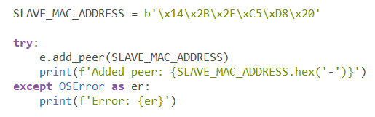
3. Set up send and receive device:
a. Send device:
- Step 1: Initialize Network and ESP-NOW
- Step 2: Add a peer device (the receiver). You need to know the receiver MAC address
Send to 14:2B:2F:C5:D8:20
5C:01:3B:4B:41:CC

Slide 6
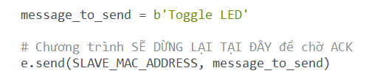
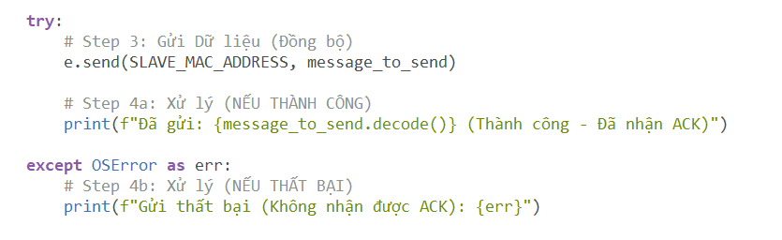
3. Set up send and receive device:
a. Send device:
Send to 14:2B:2F:C5:D8:20
- Step 3: Send a message to the peer device
5C:01:3B:4B:41:CC
Send to 8D:49:59:63:FC:C4
- Step 4: Process the result
CD:89:49:53:F8:C4

Slide 7
3. Set up send and receive device:
b. Receive device:
- Step 1: Initialize Network and ESP-NOW
- Step 2: Wait and Receive message from sender
- Step 3: Save the message into a variable and process it
Receive from 5C:01:3B:4B:41:CC
8D:49:59:63:FC:C4

Slide 8
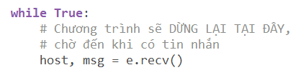
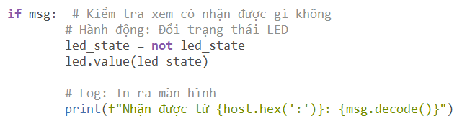
3. Set up send and receive device:
b. Receive device:
- Step 1: Initialize Network and ESP-NOW (same as Send device)
- Step 2: Wait and Receive message from sender
Content in this WHILE loop
- Step 3: Save the message into a variable and process it

Slide 9
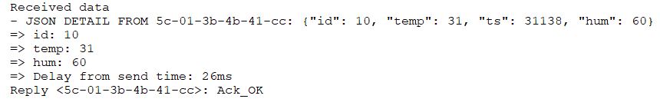
4. Advantages and Disadvantages:
a. Advantages:
- Speed and Latency: Biggest advantages. As a non-connection, the time it need to “wake up” and send data is just a few milisecond
- Range: Better then Wi-Fi and Bluetooth (can be 200 meter as ideal condition)
- Easy to set up: You don't need a complex network infrastructure. Just 2 ESPs are enough.

Slide 10
4. Advantages and Disadvantages:
b. Disadvantages:
- Proprietary: Biggest disadvantage. ESP-NOW just work on EPSs
ESP-NOW
ESP-NOW
- Payload Limit: Maximum of the data package is just 250 bytes data. A Audio or video data can push the protocol to its limits.
- Limit the num of devices: only have a maximum of 10 encrypted devices in Station mode
- No IP Networking

Slide 11
5. When should and shouldn't you use ESP-NOW?
a. You should, when . . . :
- Need instant response: Controllers for robots, drones, RC cars; buttons for controlling lights.
- Need battery-powered devices (low power): Wireless sensor networks (temperature, humidity, brightness) send data periodically to a central station.
- Need longer range: Control devices in the yard, warehouse, or between floors without a router.
- Need simple local area networks: Devices just need to "talk" to each other without an Internet connection (like a motion sensor triggers an alarm, both are ESPs).

Slide 12
5. When should and shouldn't you use ESP-NOW?
a. You shouldn’t, when . . . :
- Need to communicate with a phone or computer: (Use Bluetooth LE or Wi-Fi).
- Need to transfer large amounts of data: Stream high-quality audio, images, video, or send files. (Use Wi-Fi).
- Need each device to have an IP address: For access and configuration via a web browser. (Use Wi-Fi).

Slide 13
Thanks For Listening

